Slide 1

College Admission Portal A Project by K.K. Sai Neeraj & Team

Slide 2

Agenda
Topic one
-> Introduction
Topic two
->Objective
Topic three
-> Why C,DSA
Topic four
-> Algorithm
Topic five
->Lesson Learnt
Topic six
->Images
Topic seven
-> Output

Slide 3

Role | Name | Roll Number
Team Lead | K.K. Sai Neeraj | 24KB1A05U5
Member | T. Sapthagiri | 24KB1A05LP
Member | S.K. Akmal | 24KB1A05HA
Member | T. Hemanth | 24KB1A05KV

Slide 4
Introduction ->College Admission System simplifies the student admission process. ->Allows students to register and view available departments. ->Saves admission records securely into a file for future reference. ->Makes admission faster, paperless, and error-free.

Slide 5
Objective ->To create a simple admission system where students can register their details. ->To display all available departments clearly. ->To store the admission list into a file securely. ->To practice file handling, structure, and string manipulation in C language.

Slide 6
Why C Language and DSA? C language : ->Provides excellent support for system-level programming like file management. ->Fast execution and easy memory control. Data structures and algorithms (dsa): ->Structures help organize student records properly. ->Algorithms manage searching, sorting, and updating admission data efficiently.

Slide 7
Algorithm for College Admission System Step 1-> ->Start the program. Step 2-> ->Display the main menu with options: step3-> ->Take the user’s choice. Step4-> ->If user selects 1 (Register Student): ->Prompt the user to enter student details: •Name •Roll Number •Department •Open the admission file in append mode. •Save the student details into the file. •Close the file. •Display “Student Registered Successfully”. Step5-> •If user selects 2 (Show Available Departments): •Display a list of departments (e.g., CSE, ECE, EEE, ME, CE, etc.). Step6-> •If user selects 3 (Exit): •Terminate the program. Step7-> •If invalid input is given: •Display “Invalid choice. Please try again.” step8-> •Loop back to the main menu until the user chooses to Exit. Step9-> •End the program.

Slide 8
Lesson Learnt ->Learned how to handle file operations (read, write, append) in C. ->Improved understanding of struct usage for real-world applications. ->Practiced designing menu-driven programs. ->Learned how DSA makes information management efficient.

Slide 9
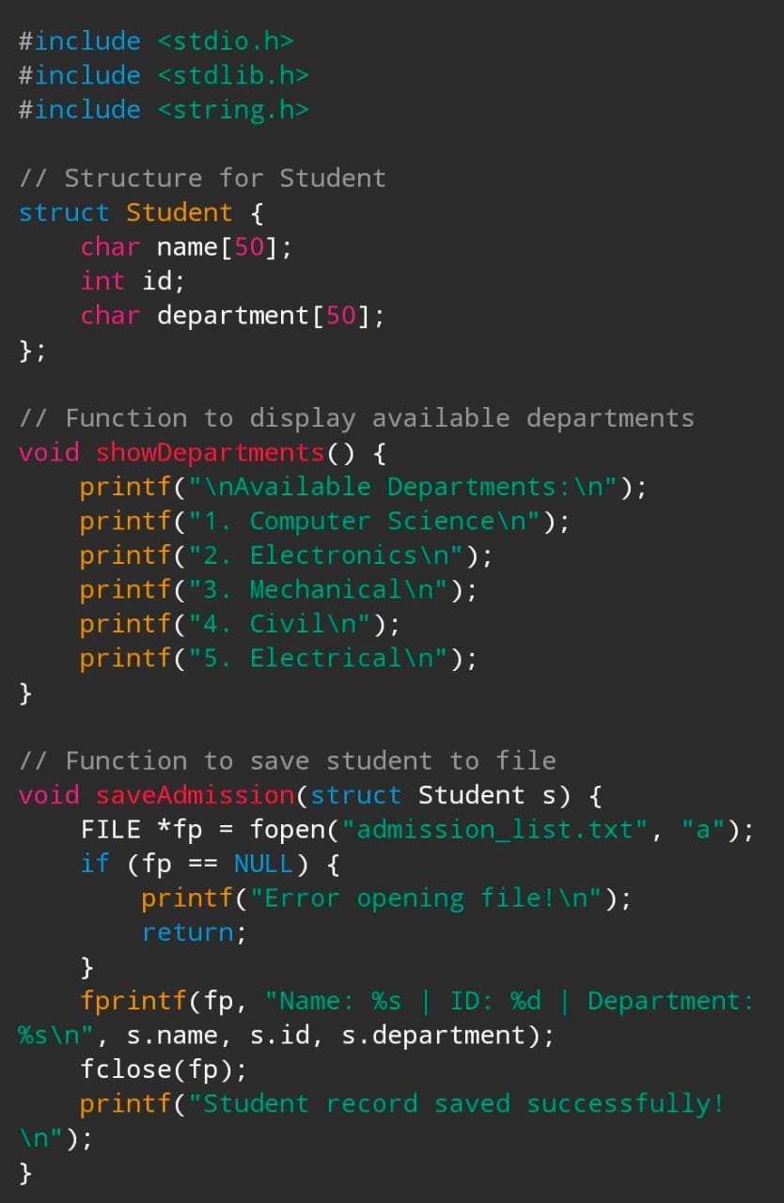
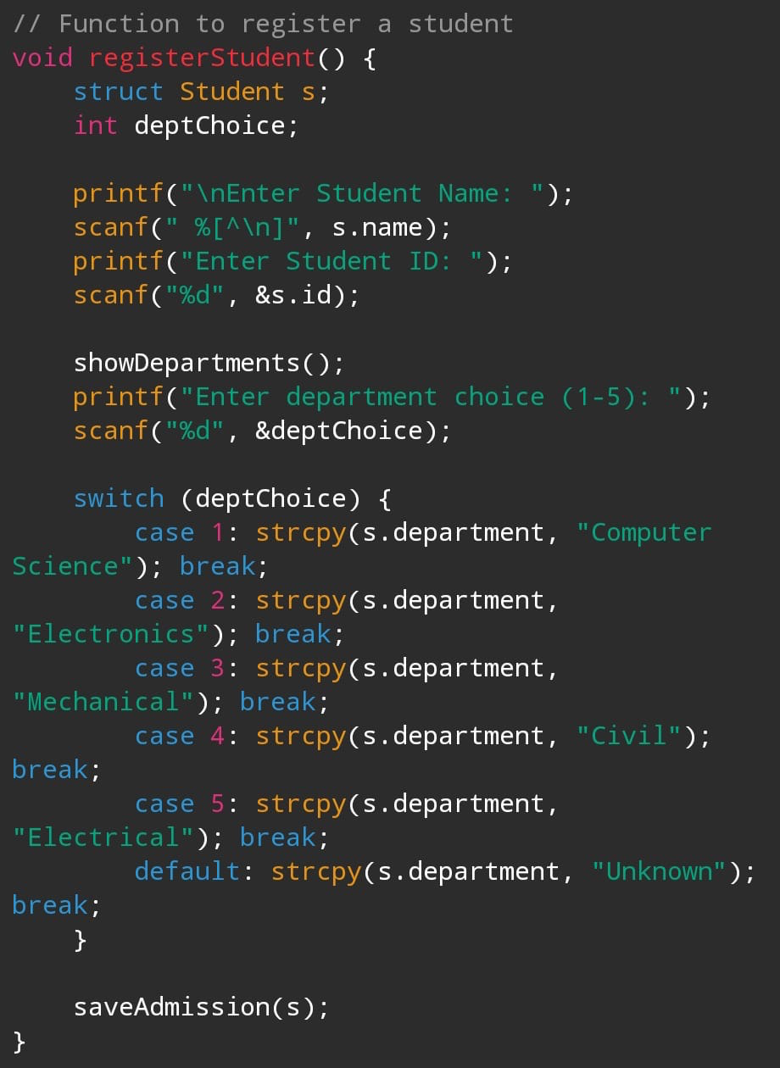
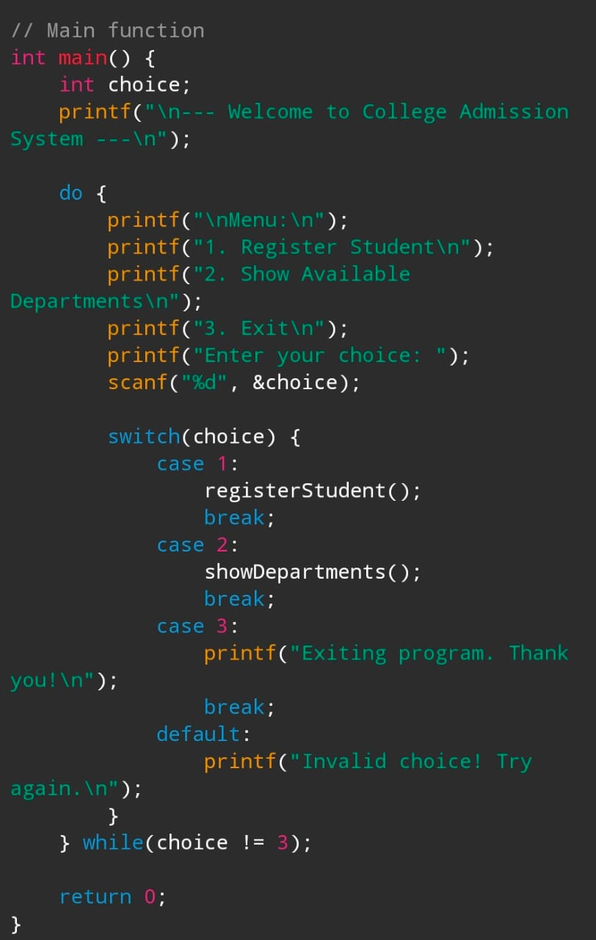
ImageS

Slide 10
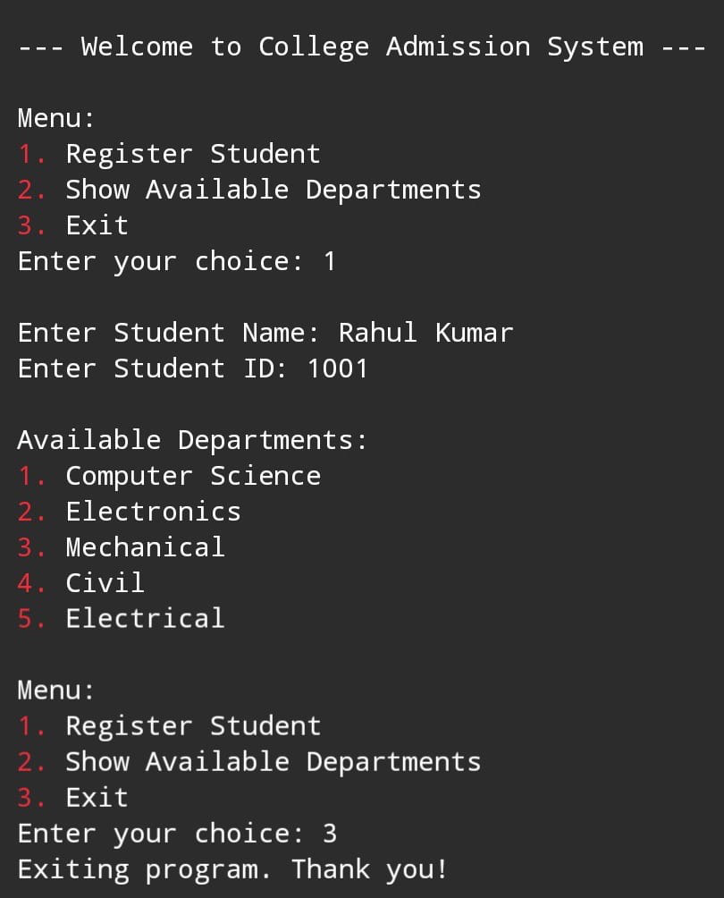
Output

Slide 11

Thank you By K.K.Sai Neeraj and Team

